Slide 1



SEQUENCE DETECTOR USING MOORE AND MEALY MACHINE
MINI PROJECT 2B
Presentation on
GUIDE: Prof. Atul Kadam
GROUP MEMBERS:
GOPAL CHANDORA B-45
ARVIND JAISWAL B-23
AYUSH PANDEY B-33
YASH SHRIVASTAV B-24

Slide 2
CONTENT:
Abstract
Introduction
Goals and Objective
Working of Moore machine and Mealy machine
Flow chart
Results
Applications
Conclusion
Notes:
Image source:-
https://pixabay.com/en/technology-industry-big-data-cpu-3092486/

Slide 3
ABSTRACT:
A finite state machine contains a finite number of states and produces outputs on state transitions after receiving inputs.
Finite state machines are widely used to model systems in diverse areas, including sequential circuits, certain types of programs, and, more recently, communication protocols.
In a testing problem we have a machine about which we lack some information; we would like to deduce this information by providing a sequence of inputs to the machine and observing the outputs produced.
Notes:
Image source:-
https://pixabay.com/en/technology-industry-big-data-cpu-3092486/

Slide 4

INTRODUCTION
‹#›
A Finite state machine is a graphical approach to design complex digital systems. Finite state machines can be used to model real world problems in many fields, including traffic signals, artificial intelligence, and vending machine. The basic concept of an FSM is to store a sequence of states and transition between the states depending on the values of the external inputs and the current state of the machine.
The FSM can be of two types:
Moore FSM
Mealy FSM.

Slide 5

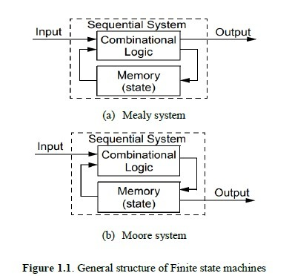
In Moore FSM, the output of the state machine is purely dependent on the current state variables, whereas the output can depend on the current state variable values and current input values in Mealy system. The general structure of Mealy and Moore FSM

Slide 6
GOALS AND OBJECTIVE:
There are two basic ways to design clocked sequential circuits. These are using:
Mealy Machine.
Moore Machine.
The objectives of this lesson are:
Study Mealy and Moore machines
Comparison of the two machine types
Timing diagram and state machines
Notes:
Image source:-
https://pixabay.com/en/computer-keyboard-apple-laptop-2563737/

Slide 7
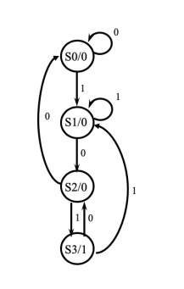
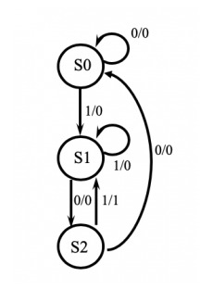
Working of Moore machine and Mealy machine:
101 sequence detector using Moore machine (Overlapping):
101 sequence detector using Mealy machine (Overlapping):

Slide 8
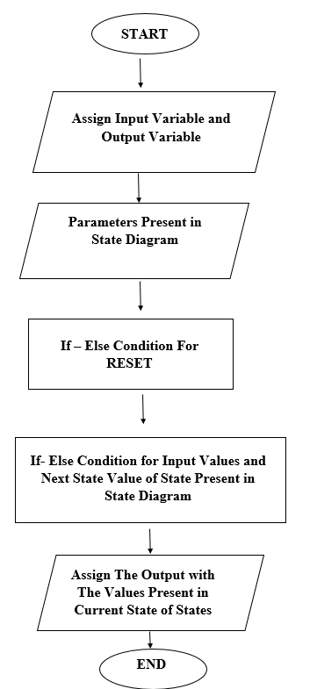
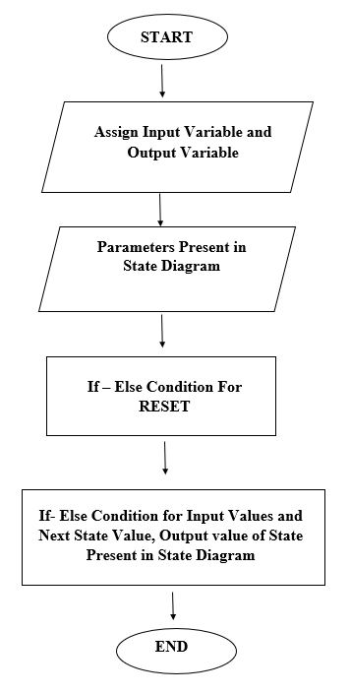
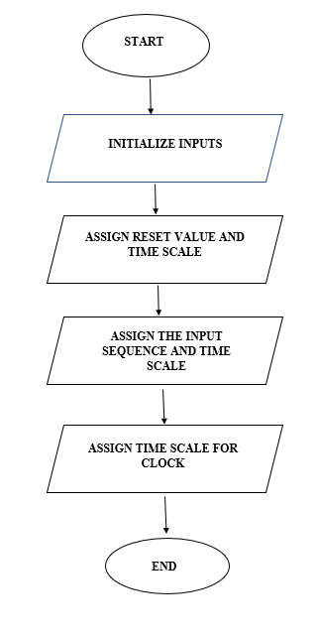
FLOWCHART:
Flow chart of Moore Machine
Flow chart of Mealy Machine
Flow chart of test bench

Slide 9
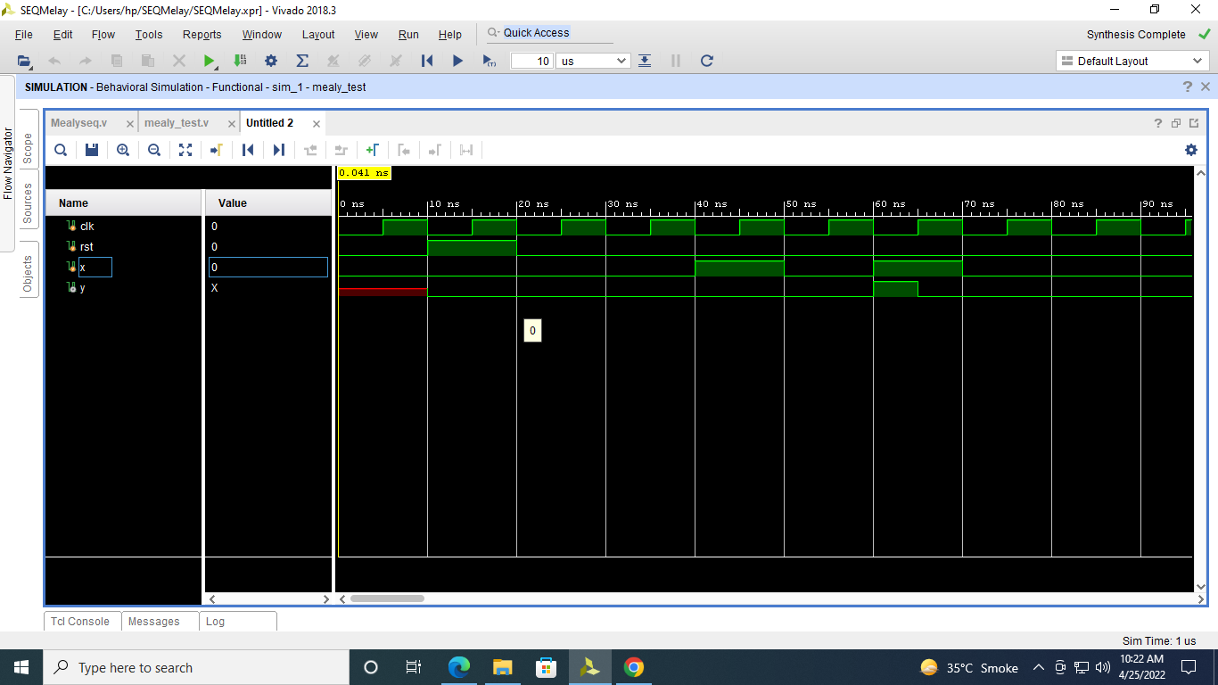
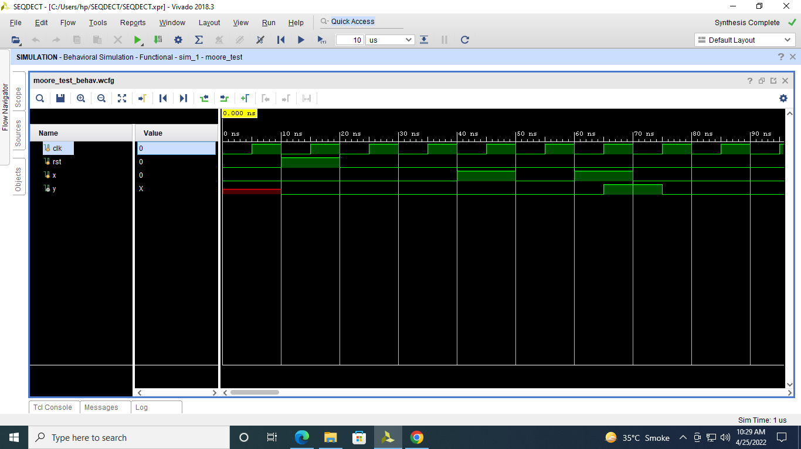
RESULTS:
Result of Mealy Machine
Result of Moore Machine
Notes:
Image source:-
https://pixabay.com/en/architecture-building-business-2179108/

Slide 10
APPLICATIONS:
Implementation of Elevator functionality using a state diagram.
Vending Machine
Traffic Light Controller
Recognition of speech
language processing

Slide 11
CONCLUSION:
Hence, we have simulated 101 sequence detectors using Moore and mealy machine in Xilinx Vivado software. The output has generated in waveform for the given inputs sequence.
• Mealy and Moore state machines are very important concepts in digital design.
• These state machine can be used in the design of mathematical algorithms.
• Mealy and Moore state machines can come in both simple (having one input and output) to complex (having many inputs and outputs) types.

Slide 12
REFERENCES
https://docs.google.com/document/d/13wEh59HTTCOkRCc-CLg7H5htm2oG_jjp/edit?usp=sharing&ouid=106883061211938960078&rtpof=true&sd=true
http://www.warse.org/IJATCSE/static/pdf/file/ijatcse122912020.pdf
https://www.slideshare.net/Munib6233/moore-and-mealy-machine
https://www.xilinx.com/
https://www.edaplayground.com/
https://www.javatpoint.com/verilog
https://www.geeksforgeeks.org/
https://drive.google.com/file/d/1O7TWXtlCDQiBOcb9ZjBDXy7hYuOoJTon/view?usp=sharing

Slide 13
THANK YOU!!

